Slide 1
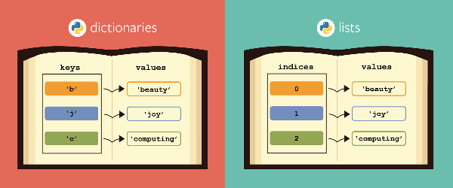

Mini Recommendation Project
1- Data Structure
2- Recommendations
3- Demonstration

Slide 2

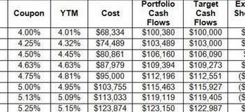
Data set and work groups definition
Data set exploitation
Work Groups

